Slide 1

Welcome!
Sunday
  Bible Study 9:30 AM
  Worship 10:30 AM
  PM Bible Class (Livestream) 5:00 PM
Wednesday
  Bible Class 7:00 PM
www.SunsetchurchofChrist.net

Slide 2
John 8:21-30
Jesus reveals His goal
Belief in Jesus
Speaking from the Father

Slide 3
Welcome!
Sunday
  Bible Study 9:30 AM
  Worship 10:30 AM
  PM Bible Class (Livestream) 5:00 PM
Wednesday
  Bible Class 7:00 PM
www.SunsetchurchofChrist.net

Slide 4

Opening Prayer
Song – | Grant Haines
Scripture Reading | Lamar McDonald
Song – | Grant Haines
Song – | Grant Haines
Lord’s Supper | Lamar McDonald / Anthony Ward
Song – | Grant Haines
Collection | Lamar McDonald / Anthony Ward
Song – | Grant Haines
Lesson | Brian Haines
Song – | Grant Haines
Closing | Ryan Sollars

Slide 5
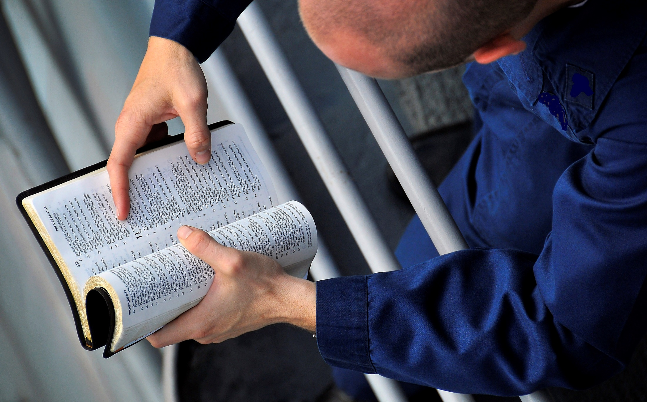
Ev-Angelism
Notes:
Evangelism – ev “Good”, angel “messenger”

Slide 6
Evangelism
"The blind see and the lame walk; the lepers are cleansed and the deaf hear; the dead are raised up and the poor have the gospel preached to them” Matthew 11:5
Notes:
Ac 21:8 ¶ On the next day we who were Paul's companions departed and came to Caesarea, and entered the house of Philip the evangelist, who was one of the seven, and stayed with him.
Eph 4:11 And He Himself gave some to be apostles, some prophets, some evangelists, and some pastors and teachers,
2Ti 4:5 But you be watchful in all things, endure afflictions, do the work of an evangelist, fulfill your ministry.

Slide 7
Evangelism
The Gospel: the New Testament
The law is not made for a righteous person, but for the lawless …… and if there is any other thing that is contrary to sound doctrine, according to the glorious gospel of the blessed God which was committed to my trust. 1 Timothy 1:9,10-11

Slide 8
Evangelism
The Gospel: the New Testament
The law is not made for a righteous person, but for the lawless …… and if there is any other thing that is contrary to sound doctrine, according to the glorious gospel of the blessed God which was committed to my trust. 1 Timothy 9,10-11

Slide 9
Evangelism
Is evangelism to the lost only?
So, as much as is in me, I am ready to preach the gospel to you who are in Rome. Romans 1:15a

Slide 10
Evangelism
The Gospel is a solution:
To emotional struggles
Philippians 4:7-9
Notes:
Php 4:7 and the peace of God, which surpasses all understanding, will guard your hearts and minds through Christ Jesus. 8 Finally, brethren, whatever things are true, whatever things are noble, whatever things are just, whatever things are pure, whatever things are lovely, whatever things are of good report, if there is any virtue and if there is anything praiseworthy--meditate on these things. and the peace of God, which surpasses all understanding, will guard your hearts and minds through Christ Jesus. Php 4:9 The things which you learned and received and heard and saw in me, these do, and the God of peace will be with you.

Slide 11
Evangelism
The Gospel is a solution:
To emotional struggles
To social injustice
Galatians 3:28
James 2:1
Notes:
Ga 3:28 There is neither Jew nor Greek, there is neither slave nor free, there is neither male nor female; for you are all one in Christ Jesus.
Jas 2:1 ¶ My brethren, do not hold the faith of our Lord Jesus Christ, the Lord of glory, with partiality.

Slide 12
Evangelism
The Gospel is a solution:
To emotional struggles
To social injustice
To physical need
Acts 2:44-45
Notes:
Ac 2:44 Now all who believed were together, and had all things in common, 45 and sold their possessions and goods, and divided them among all, as anyone had need.

Slide 13
Evangelism
The Gospel is a solution:
To emotional struggles
To social injustice
To physical need
To familial stability
Ephesians 5:22-6:4
Notes:
Eph 6:1 ¶ Children, obey your parents in the Lord, for this is right. 2 "Honor your father and mother," which is the first commandment with promise: 3 "that it may be well with you and you may live long on the earth.“ 4 And you, fathers, do not provoke your children to wrath, but bring them up in the training and admonition of the Lord.

Slide 14
Evangelism
The Gospel is a solution:
To emotional struggles
To social injustice
To physical need
To familial stability
To eternal destiny

Slide 15
Evangelism
Romans 1:16
For I am not ashamed of the gospel of Christ, for it is the power of God to salvation for everyone who believes, for the Jew first and also for the Greek
The Gospel is a solution:
To emotional struggles
To social injustice
To physical need
To familial stability
To eternal destiny

Slide 16
Day to Day Evangelists
1. Be different - 2 Corinthians 6:17
Notes:
Therefore "Come out from among them And be separate, says the Lord. Do not touch what is unclean, And I will receive you.“

Slide 17
Day to Day Evangelists
1. Be different – 2 Corinthians 6:17
2. Be ready with an answer – 1 Peter 3:15
Notes:
1Pe 3:15 But sanctify the Lord God in your hearts, and always be ready to give a defense to everyone who asks you a reason for the hope that is in you, with meekness and fear;

Slide 18
Day to Day Evangelists
1. Be different – 2 Corinthians 6:17
2. Be ready with an answer – 1 Peter 3:15
3. Be patient – 2 Timothy 2:23-26
Notes:
2Ti 2:23 But avoid foolish and ignorant disputes, knowing that they generate strife. 24 And a servant of the Lord must not quarrel but be gentle to all, able to teach, patient, 25 in humility correcting those who are in opposition, if God perhaps will grant them repentance, so that they may know the truth, 26 and that they may come to their senses and escape the snare of the devil, having been taken captive by him to do his will.

Slide 19
Day to Day Evangelists
1. Be different – 2 Corinthians 6:17
2. Be ready with an answer – 1 Peter 3:15
3. Be patient – 2 Timothy 2:23-26
4. Be loving – Luke 6:27
Notes:
Lu 6:27 ¶ "But I say to you who hear: Love your enemies, do good to those who hate you,

Slide 20
Day to Day Evangelists
1. Be different – 2 Corinthians 6:17
2. Be ready with an answer – 1 Peter 3:15
3. Be patient – 2 Timothy 2:23-26
4. Be loving – Luke 6:27
5. Pray – Colossians 4:3
Notes:
Col 4:3 meanwhile praying also for us, that God would open to us a door for the word, to speak the mystery of Christ, for which I am also in chains,

Slide 21
Day to Day Evangelists
let him know that he who turns a sinner from the error of his way will save a soul from death and cover a multitude of sins. James 5:20

Slide 23
“What must I do to be saved?" Acts 16:30
Notes:
Ac 15:11 "But we believe that we are saved through the grace of the Lord Jesus, in the same way as they also are."

Slide 24
“What must I do to be saved?" Acts 16:30
A question of connection
Notes:
Ac 15:11 "But we believe that we are saved through the grace of the Lord Jesus, in the same way as they also are."

Slide 25
“What must I do to be saved?" Acts 16:30
A question of connection
A requirement
Notes:
Ac 15:11 "But we believe that we are saved through the grace of the Lord Jesus, in the same way as they also are."

Slide 26
“What must I do to be saved?" Acts 16:30
A question of connection
A requirement
The individual
Notes:
Ac 15:11 "But we believe that we are saved through the grace of the Lord Jesus, in the same way as they also are."

Slide 27
“What must I do to be saved?" Acts 16:30
A question of connection
A requirement
The individual
Action or behavior
Notes:
Ac 15:11 "But we believe that we are saved through the grace of the Lord Jesus, in the same way as they also are."

Slide 28
“What must I do to be saved?" Acts 16:30
A question of connection
A requirement
The individual
Action or behavior
Transformed to escape
Notes:
Ac 15:11 "But we believe that we are saved through the grace of the Lord Jesus, in the same way as they also are."

Slide 29
“What must I do to be saved?" Acts 16:30
“Believe on the Lord” – Acts 16:30
“Confess with your mouth” – Rom. 10:9
“Repent of your sins” – Acts 2:38
“Be baptized” – Acts 22:16
Notes:
Ac 15:11 "But we believe that we are saved through the grace of the Lord Jesus, in the same way as they also are."

